Slide 1
Fundamental components that make up an Android application
Sulaxan Jadhav

Slide 2
Agenda
Building Blocks of Android: An introduction to the key components that form the foundation of any Android app.
Activity Life-cycle: A detailed look at the various states an activity goes through during its lifetime and how to manage them.
LogCat: An essential tool for debugging and monitoring your app's behavior.

Slide 3
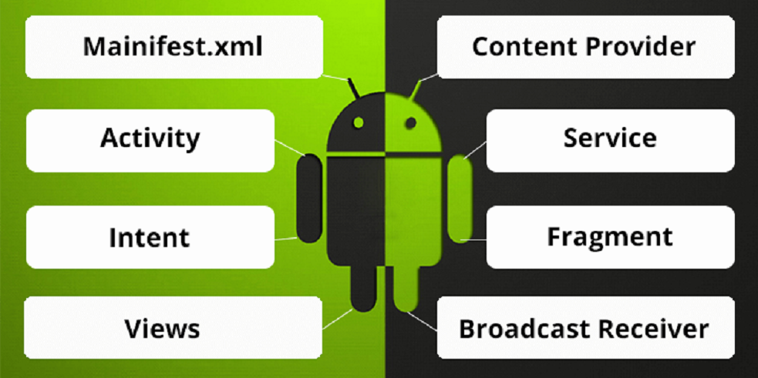

Slide 4
Importance of Understanding the Building Blocks of Android
Core Knowledge: Understanding these building blocks is crucial for any Android developer as they form the foundation of all Android applications.
Efficient Development: Knowing how to effectively use and manage these components will lead to more efficient and maintainable code.
Debugging and Maintenance: Familiarity with the lifecycle and debugging tools like LogCat will help in identifying and fixing issues quickly.
Professional Growth: Mastery of these concepts is essential for advancing in the field of Android development and for building robust, high-quality apps.

Slide 5
Android Components
Activities: What they are, lifecycle, and examples
Services: Background processing, types, and examples
Broadcast Receivers: What they are, how to use them, and examples
Content Providers: Accessing data in other apps, examples

Slide 6
2.1 Activities
What They Are:
Activities are the building blocks of an Android app's user interface.
Each activity represents a single screen with which users can interact.
Activities are where most of the application's user interface and user interaction logic is placed.

Slide 7
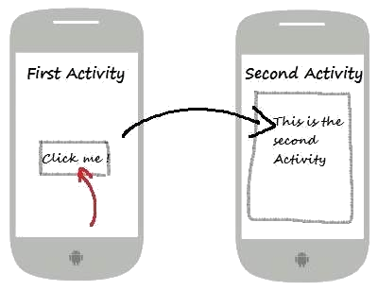

Slide 8
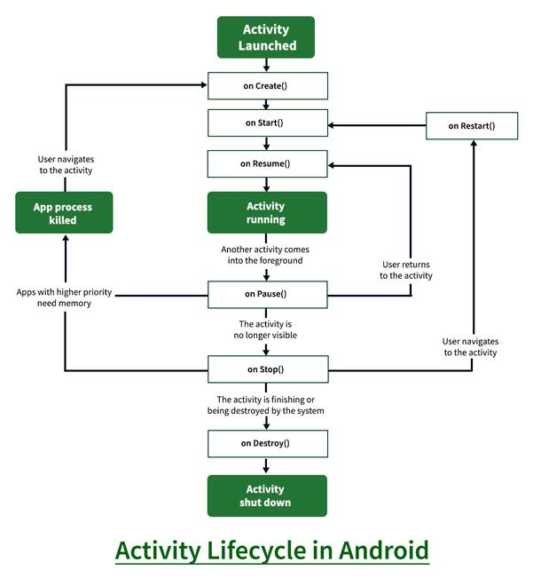

Slide 9
Activity Lifecycle
onCreate(): Called when the activity is first created. Initialize your activity here.
onStart(): Called when the activity becomes visible to the user.
onResume(): Called when the activity starts interacting with the user.
onPause(): Called when the system is about to start resuming another activity.
onStop(): Called when the activity is no longer visible to the user.
onDestroy(): Called before the activity is destroyed.
onRestart(): Called after the activity has been stopped, just before it is started again.

Slide 10
onCreate()
When It's Called: This method is called when the activity is first created.
Purpose:
This is where you should do all the static setup: create views, bind data to lists, and instantiate objects.
You also typically call setContentView() to define the layout for the activity's user interface.

Slide 11
@Override
protected void onCreate(Bundle savedInstanceState) {
super.onCreate(savedInstanceState);
setContentView(R.layout.activity_main);
// Initialize your views and other components here
}

Slide 12
onStart()
When It's Called: This method is called when the activity becomes visible to the user.
Purpose:
It is a good place to refresh any UI elements that might need updating.
The activity is about to become visible, but not yet interactive.

Slide 13
@Override
protected void onStart() {
super.onStart();
// Code to prepare the activity to become visible
}

Slide 14
onResume()
When It's Called: This method is called when the activity starts interacting with the user.
Purpose:
The activity has moved to the foreground and is now interactive.
This is the state in which the app interacts with the user.

Slide 15
@Override
protected void onResume() {
super.onResume();
// Code to start animations, acquire exclusive resources, etc.
}

Slide 16
onPause()
When It's Called: This method is called when the system is about to start resuming another activity.
Purpose:
This is where you should pause ongoing tasks, save unsaved data, and release resources that might be needed by other activities.
It’s a good place to stop animations or other ongoing actions that should not continue when the activity is not in the foreground.

Slide 17
@Override
protected void onPause() {
super.onPause();
// Pause ongoing tasks, animations, etc.
}

Slide 18
onStop()
When It's Called: This method is called when the activity is no longer visible to the user.
Purpose:
This is where you should release almost all resources that are not needed while the user is not interacting with your app.
It can be used to save data to persistent storage.

Slide 19
@Override
protected void onStop() {
super.onStop();
// Release resources, save data, etc.
}

Slide 20
onDestroy()
When It's Called: This method is called before the activity is destroyed.
Purpose:
It’s the final cleanup before the activity is completely removed from memory.
You should do all the necessary cleanup here, including terminating background threads.

Slide 21
@Override
protected void onDestroy() {
super.onDestroy();
// Cleanup any resources including stopping threads, etc.
}

Slide 22
onRestart()
When It's Called: This method is called after the activity has been stopped, just before it is started again.
Purpose:
It’s used to reinitialize any resources released during onStop().
It’s typically used to refresh any changes made while the activity was in the background.

Slide 23
@Override
protected void onRestart() {
super.onRestart();
// Code to reinitialize components released in onStop()
}

Slide 24
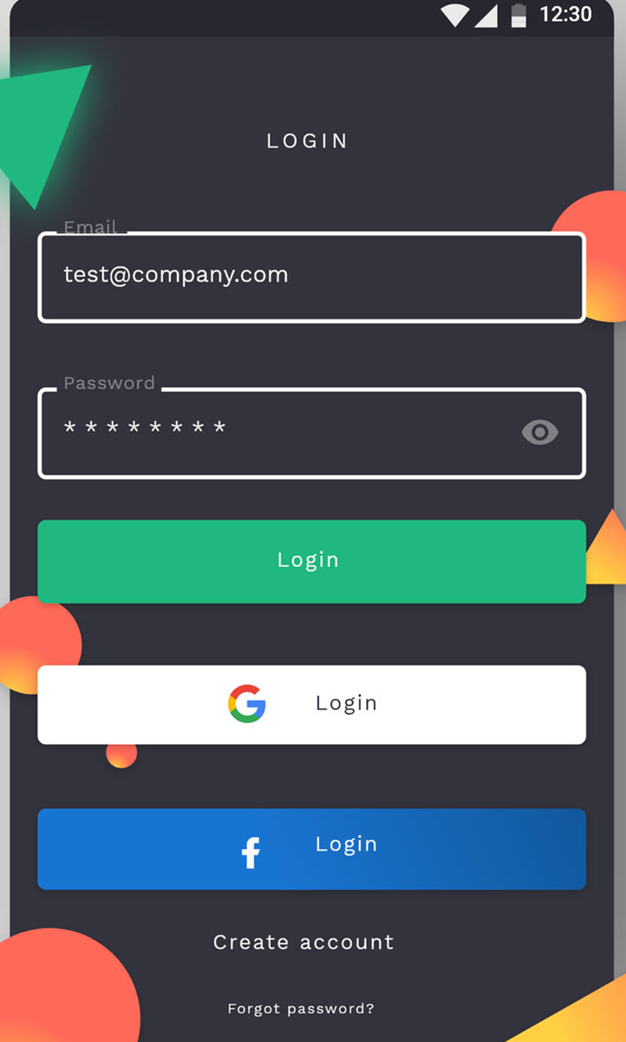

Slide 25
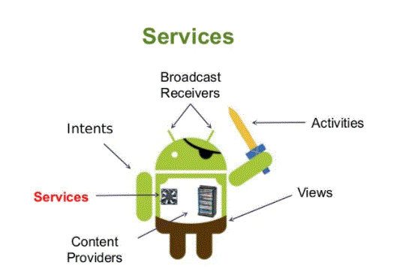

Slide 26
2.2 Services
Background Processing
Definition:
Services handle operations that need to run in the background without user interaction. They are essential for performing tasks that should continue even when the app is not in the foreground.
Characteristics:
Services do not provide a user interface.
They can run for an indefinite period or be limited to a specific duration, depending on the task.

Slide 27
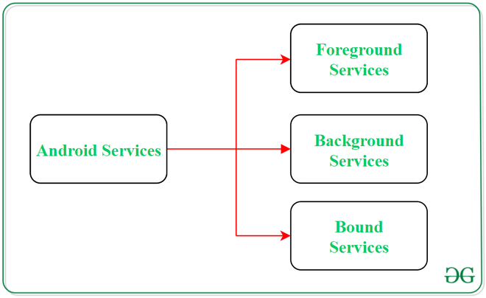

Slide 28
Types of Services
Started Services
Definition:
These services are initiated when an application component (like an activity) calls startService().
Lifecycle:
They can run indefinitely, performing a single operation, and need to stop themselves using stopSelf() or be stopped by other components using stopService().
Use Case:
Appropriate for tasks that should continue even if the initiating component is destroyed.

Slide 29
2. Bound Services
Definition:
These services allow other application components to bind to them by calling bindService().
Lifecycle:
They run only as long as another application component is bound to them. Multiple components can bind to the service simultaneously.
When no components are bound to the service, the system destroys it.
Use Case:
Ideal for services that provide a client-server interface to interact with.

Slide 30
Examples of Services
1. Music Player Service
Description:
A music player service that continues playing music even when the user navigates away from the app.
Implementation:
The service can be a started service that begins when the user plays music and stops when the user stops the music.
2. Data Fetching Service
Description:
A service that periodically fetches data from the internet.
Implementation:
The service can be scheduled using JobScheduler or AlarmManager to fetch data at regular intervals, ensuring the app remains updated even when not in the foreground.

Slide 31
Broadcast Receivers
Definition:
Broadcast Receivers are components that respond to broadcast messages (also known as events or intents) from other applications or from the Android system itself.
They allow your application to listen for and react to system-wide broadcast announcements or custom events.
Functionality:
Broadcast Receivers enable your app to perform actions based on various events, such as changes in network connectivity, battery levels, or custom events within the app.

Slide 32
How to Use Them

Slide 33
Defining a Broadcast Receiver Class:
Create a class that extends BroadcastReceiver and override the onReceive() method to define how your app responds to the broadcast.
Example: public class MyBroadcastReceiver extends BroadcastReceiver {
@Override
public void onReceive(Context context, Intent intent) {
// Handle the broadcast message
String action = intent.getAction();
if (action.equals(Intent.ACTION_BATTERY_LOW)) {
// Handle low battery event
}
}
}

Slide 34
Registering the Receiver:
In the Manifest File:
Declare your Broadcast Receiver in the AndroidManifest.xml file.

Slide 35
<receiver android:name=".MyBroadcastReceiver">
<intent-filter>
<action android:name="android.intent.action.BATTERY_LOW" />
</intent-filter>
</receiver>

Slide 36
At Runtime:
Register the Broadcast Receiver dynamically in your activity or service using registerReceiver().
Example:
MyBroadcastReceiver receiver = new MyBroadcastReceiver();
IntentFilter filter = new IntentFilter(Intent.ACTION_BATTERY_LOW);
registerReceiver(receiver, filter);

Slide 37
Examples
Responding to System Events:
Low Battery Notification:
Your app can listen for the ACTION_BATTERY_LOW broadcast to be notified when the device battery is low, allowing you to take appropriate actions such as reducing background activity.

Slide 38
public class MyBroadcastReceiver extends BroadcastReceiver {
@Override
public void onReceive(Context context, Intent intent) {
if (Intent.ACTION_BATTERY_LOW.equals(intent.getAction())) {
// Notify user or take action
}
}
}

Slide 39
Listening for Custom Events:
Data Updates within the App:
Your app can define and broadcast custom intents for internal communication, such as notifying other components when new data is available.

Slide 40
public class MyBroadcastReceiver extends BroadcastReceiver {
@Override
public void onReceive(Context context, Intent intent) {
if ("com.example.app.ACTION_DATA_UPDATED".equals(intent.getAction())) {
// Handle data update
}
}
}
// Broadcasting a custom intent
Intent intent = new Intent("com.example.app.ACTION_DATA_UPDATED");
sendBroadcast(intent);

Slide 41
2.4 Content Providers
Accessing Data in Other Apps
Definition:
Content Providers manage access to a structured set of data. They encapsulate the data, offering a consistent interface for querying, inserting, updating, and deleting data.
They provide mechanisms for defining data security, controlling which applications can access and modify the data.
Purpose:
Content Providers serve as the standard interface that connects data in one process with code running in another process.
They enable data sharing between different applications in a secure and organized manner.

Slide 42
How They Work:
URI:
Content Providers use a Uniform Resource Identifier (URI) to identify the data they manage. URIs are used to perform operations on the data.
Example URI: content://com.example.app.provider/table_name
CRUD Operations:
Query: Retrieve data from the provider.
Insert: Add new data to the provider.
Update: Modify existing data in the provider.
Delete: Remove data from the provider.

Slide 43
Examples:
1. The Contacts App:
Description:
The Contacts app uses a content provider to manage the user's contact information.
It allows other apps to query, insert, update, and delete contact data through the content provider.

Slide 44
// Querying contacts
Uri contactsUri = ContactsContract.Contacts.CONTENT_URI;
Cursor cursor = getContentResolver().query(contactsUri, null, null, null, null);
if (cursor != null && cursor.moveToFirst()) {
do {
String contactName = cursor.getString(cursor.getColumnIndex(ContactsContract.Contacts.DISPLAY_NAME));
// Process the contact name
} while (cursor.moveToNext());
cursor.close();
}

Slide 45
2. Custom Content Provider:
Description:
A custom content provider can be created to share an app's private data with other applications securely.
It allows defining permissions and access control to ensure only authorized applications can access the data.

Slide 46
3. Intents and Intent Filters
Intents:
Intents are messaging objects used to request an action from another app component. They are a fundamental part of Android development, enabling communication between different parts of an app or even between different apps.
Purpose:
To start activities, services, and broadcast receivers.
To pass data between components.
To request an action from another component (e.g., opening a web page or sending an email).

Slide 47
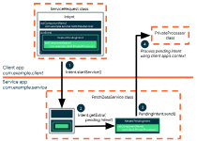

Slide 48
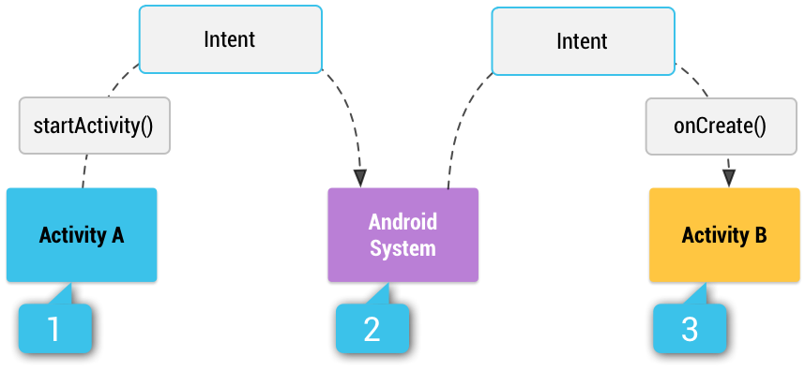

Slide 49
Intent Filters:
Intent Filters are declarations in the app’s manifest file that specify the types of intents that a component can respond to.
Purpose:
To make an activity, service, or broadcast receiver available for other apps to call.
To specify the types of intents the component is interested in and can handle.

Slide 50
1. Explicit Intents:
Definition:
Explicit intents specify the exact component to start by name (either the class name or the fully qualified component name).
Usage:
Primarily used for internal app communication where the target component is known.
Example: Intent intent = new Intent(this, TargetActivity.class);
startActivity(intent);

Slide 51
2. Implicit Intents:
Definition:
Implicit intents do not name a specific component. Instead, they declare a general action to perform, which allows any app installed on the device to handle it if it matches the intent filter criteria.
Usage:
Used when the action can be handled by multiple apps (e.g., opening a web page, sending a message).
Example: java Copy code Intent intent = new Intent(Intent.ACTION_VIEW);
intent.setData(Uri.parse("http://www.example.com"));
if (intent.resolveActivity(getPackageManager()) != null) {
startActivity(intent);
}

Slide 52
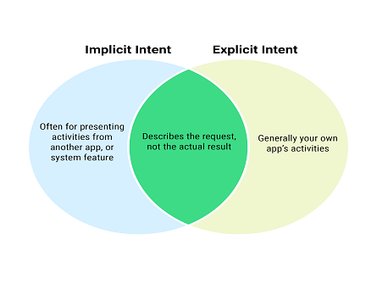

Slide 53
Intent Filters and Their Usage
Definition:
Intent Filters specify the types of intents a component can respond to. They are declared in the app's AndroidManifest.xml file.
Components of an Intent Filter:
Action: The general action to perform (e.g., ACTION_VIEW, ACTION_SEND).
Category: Provides additional information about the action to execute (e.g., CATEGORY_DEFAULT).
Data: Specifies the type of data the intent can handle (e.g., MIME type, URI scheme).

Slide 54
Usage:
Action: Defines what the component is supposed to do.
Example: android.intent.action.VIEW indicates the component can view data.
Category: Provides additional information about the action being executed.
Example: android.intent.category.DEFAULT is the default category for most intents.
Data: Defines the type of data the intent can handle.
Example: URI scheme (http), MIME type (image/*).
Handling the Intent:
When an implicit intent is sent, the system searches for all components that match the intent filter criteria. If a match is found, the corresponding activity, service, or broadcast receiver is started.

